Slide 1

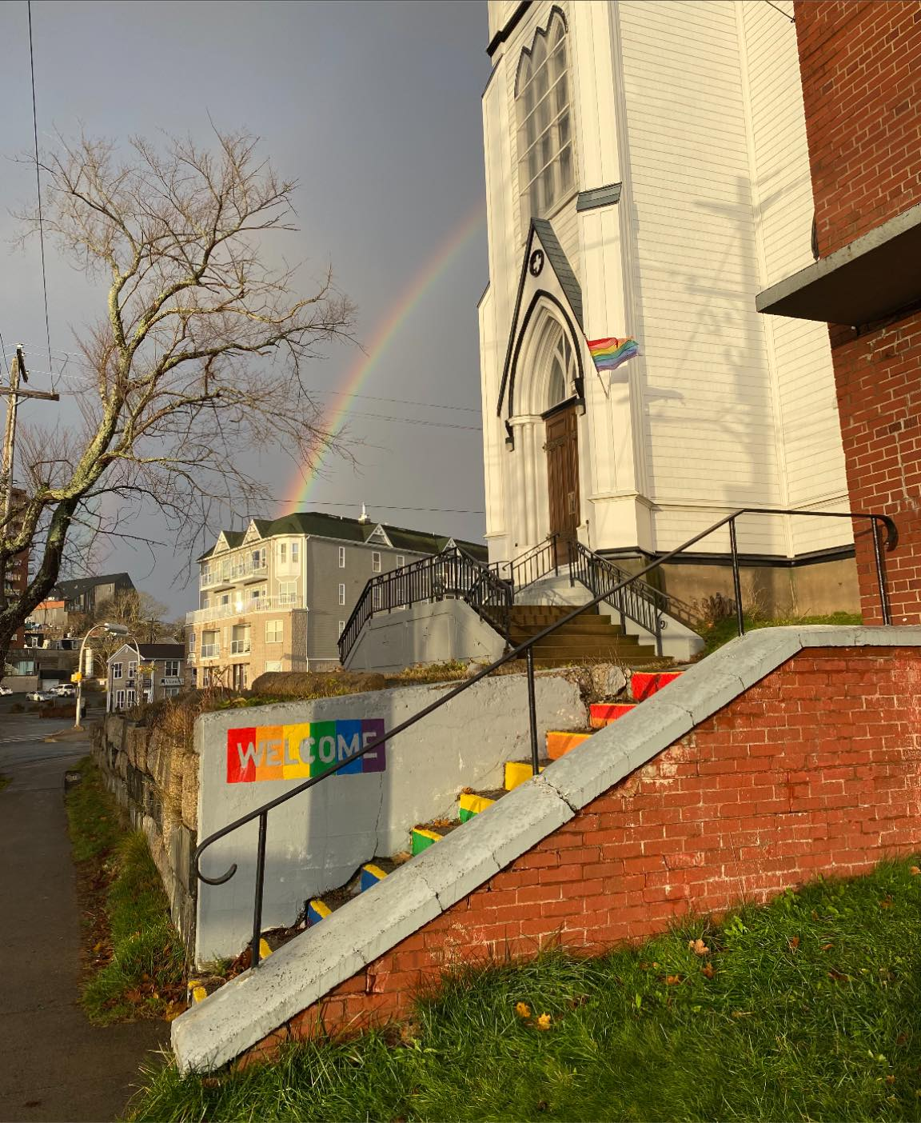

Slide 2
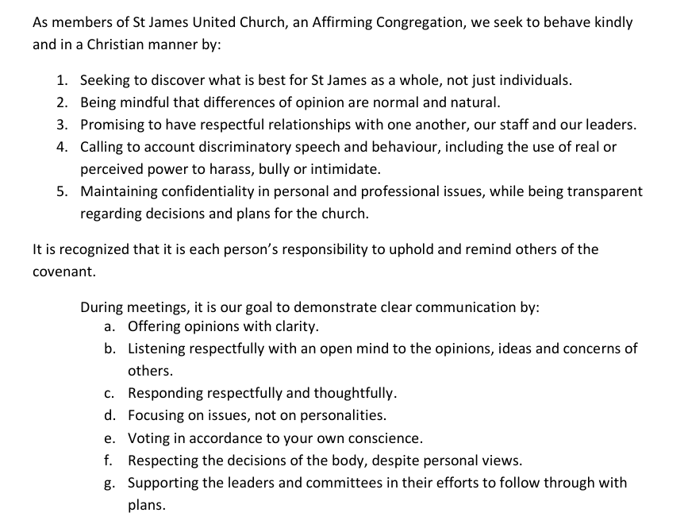
St James UC Behavioral Covenant
United in Faith
Strengthened by Friendship
Building a Community
of Love & Justice

Slide 3
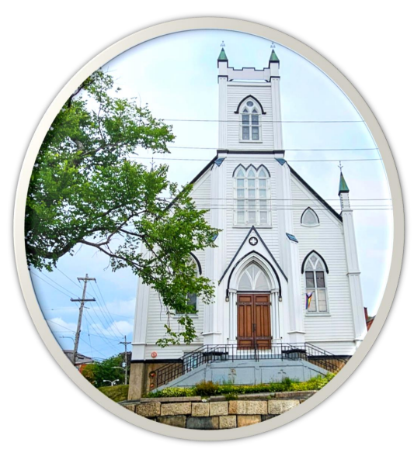
St James
United Church
Governance
as
Spiritual Practice
October 2024

Slide 4
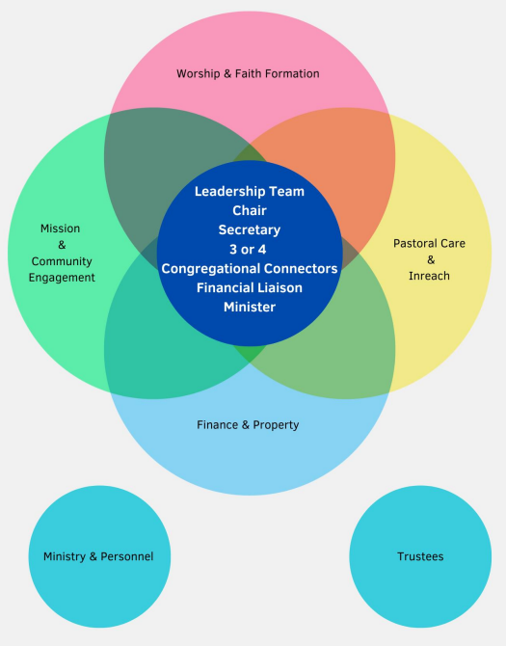
St James
United Church
Governance
Model

Slide 5
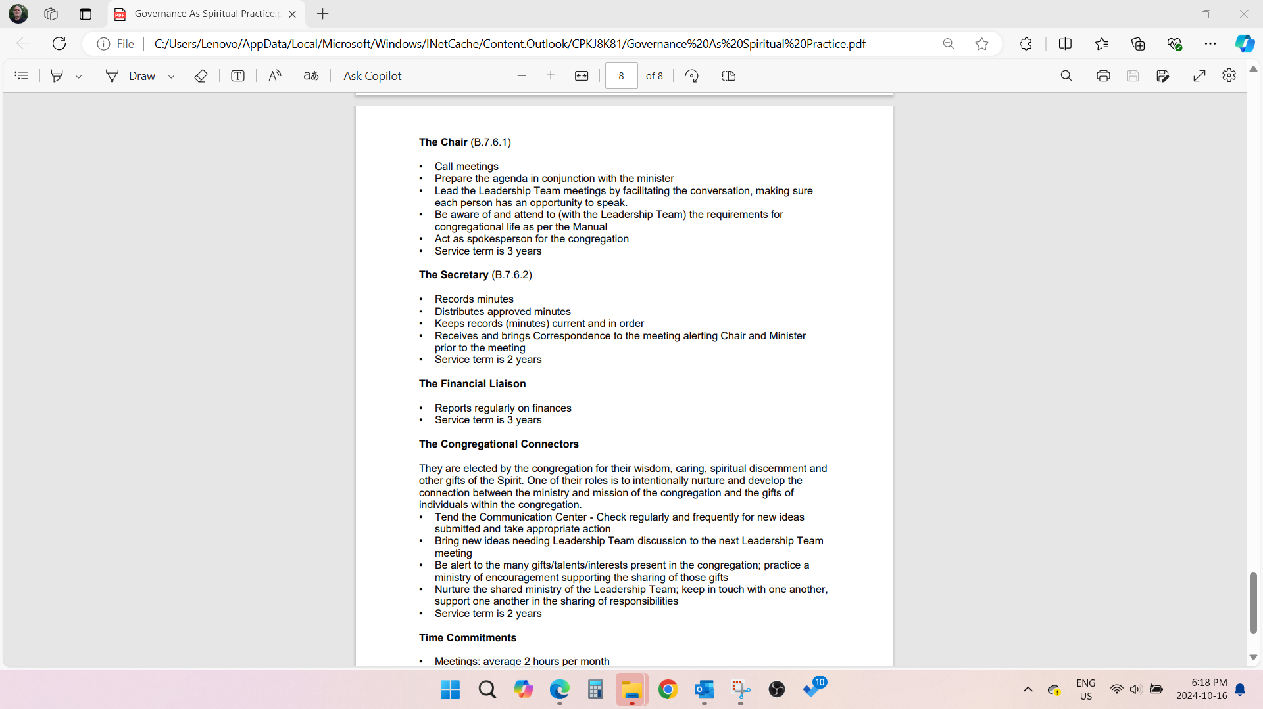
Debra Keays-White
Kathy Ibel

Slide 6
Murray Wylie
Jennifer Adams, Joan Clark, Jackie Clark, Ian Traverse,

Slide 7
St James
United Church
Governance
Model
Joyce Wylie
Wayne Cochrane

